Slide 1

Marketing Proposal
Presented by: Group 1
Helen Arrucha, Amanda Delgado, Markenson Delkhaste,
Jennie Lee, Sarah Wolfe
IBM 3072 - Promotional Strategies

Slide 2
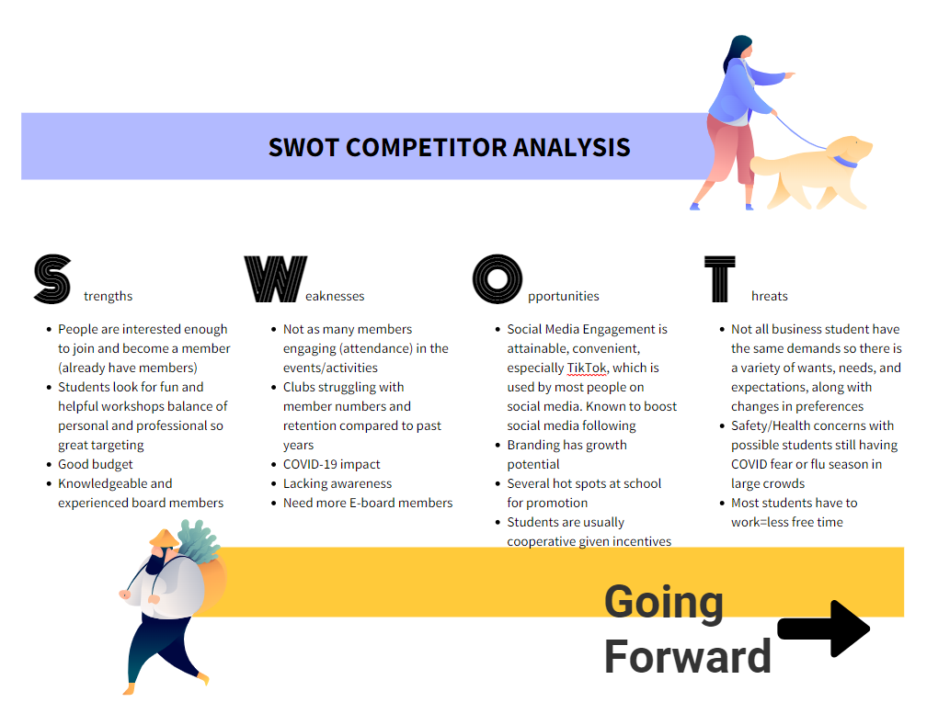
Notes:
Amanda

Slide 3
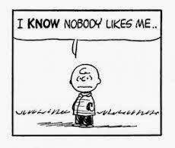
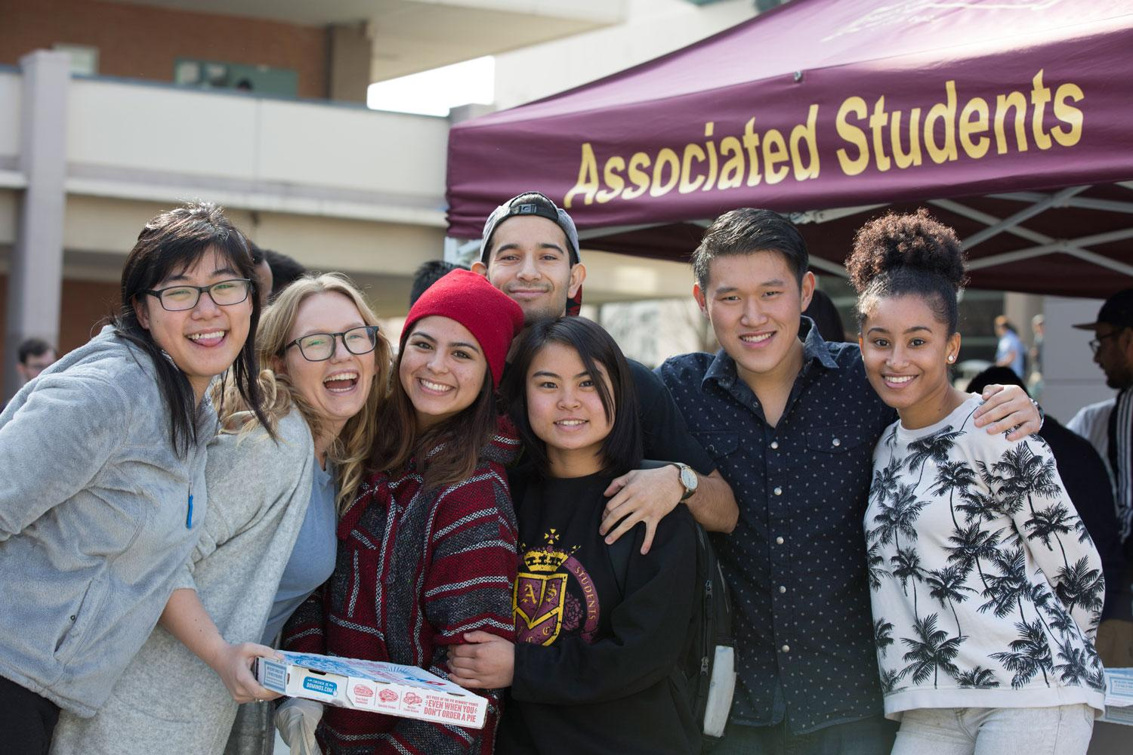
Target Market
Audience persona: business students who are looking for opportunities such as experience or potential connections
Cal Poly Pomona has many college students that are on a budget
Students might be uncertain about their future careers
So what better way than to join some of the 21 clubs under CBA?
UBSS is able to offer free advisory services and opportunities to solve students' uncertainties
Participating will create the habit of having a personal, social, sense of community, and professional work balance
Before joining clubs After joining clubs
Notes:
Markenson

Slide 4
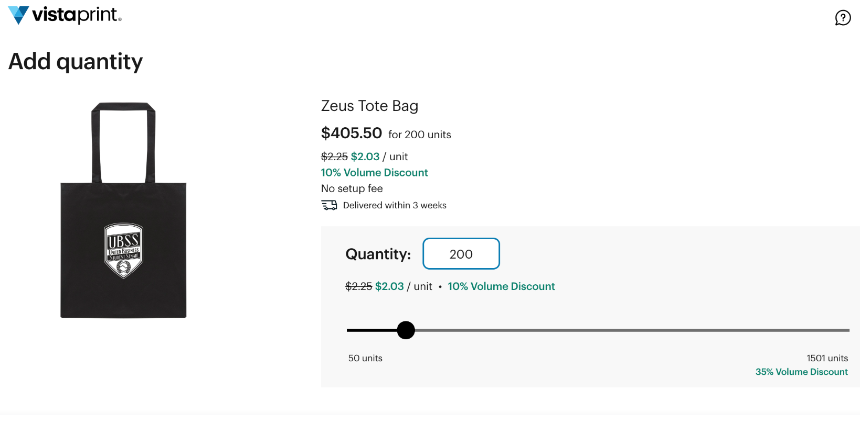
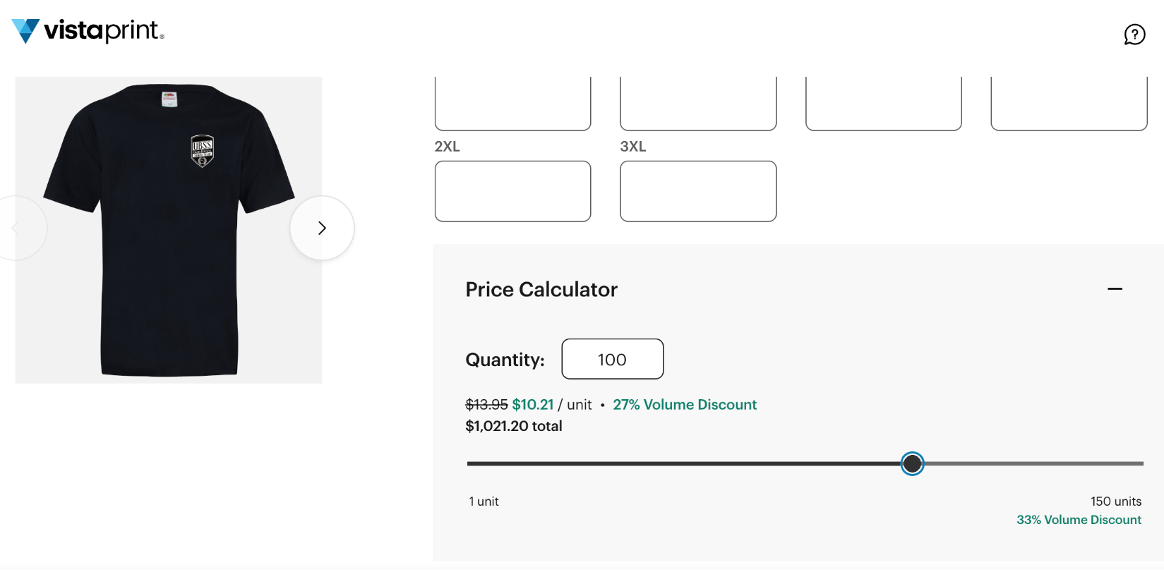
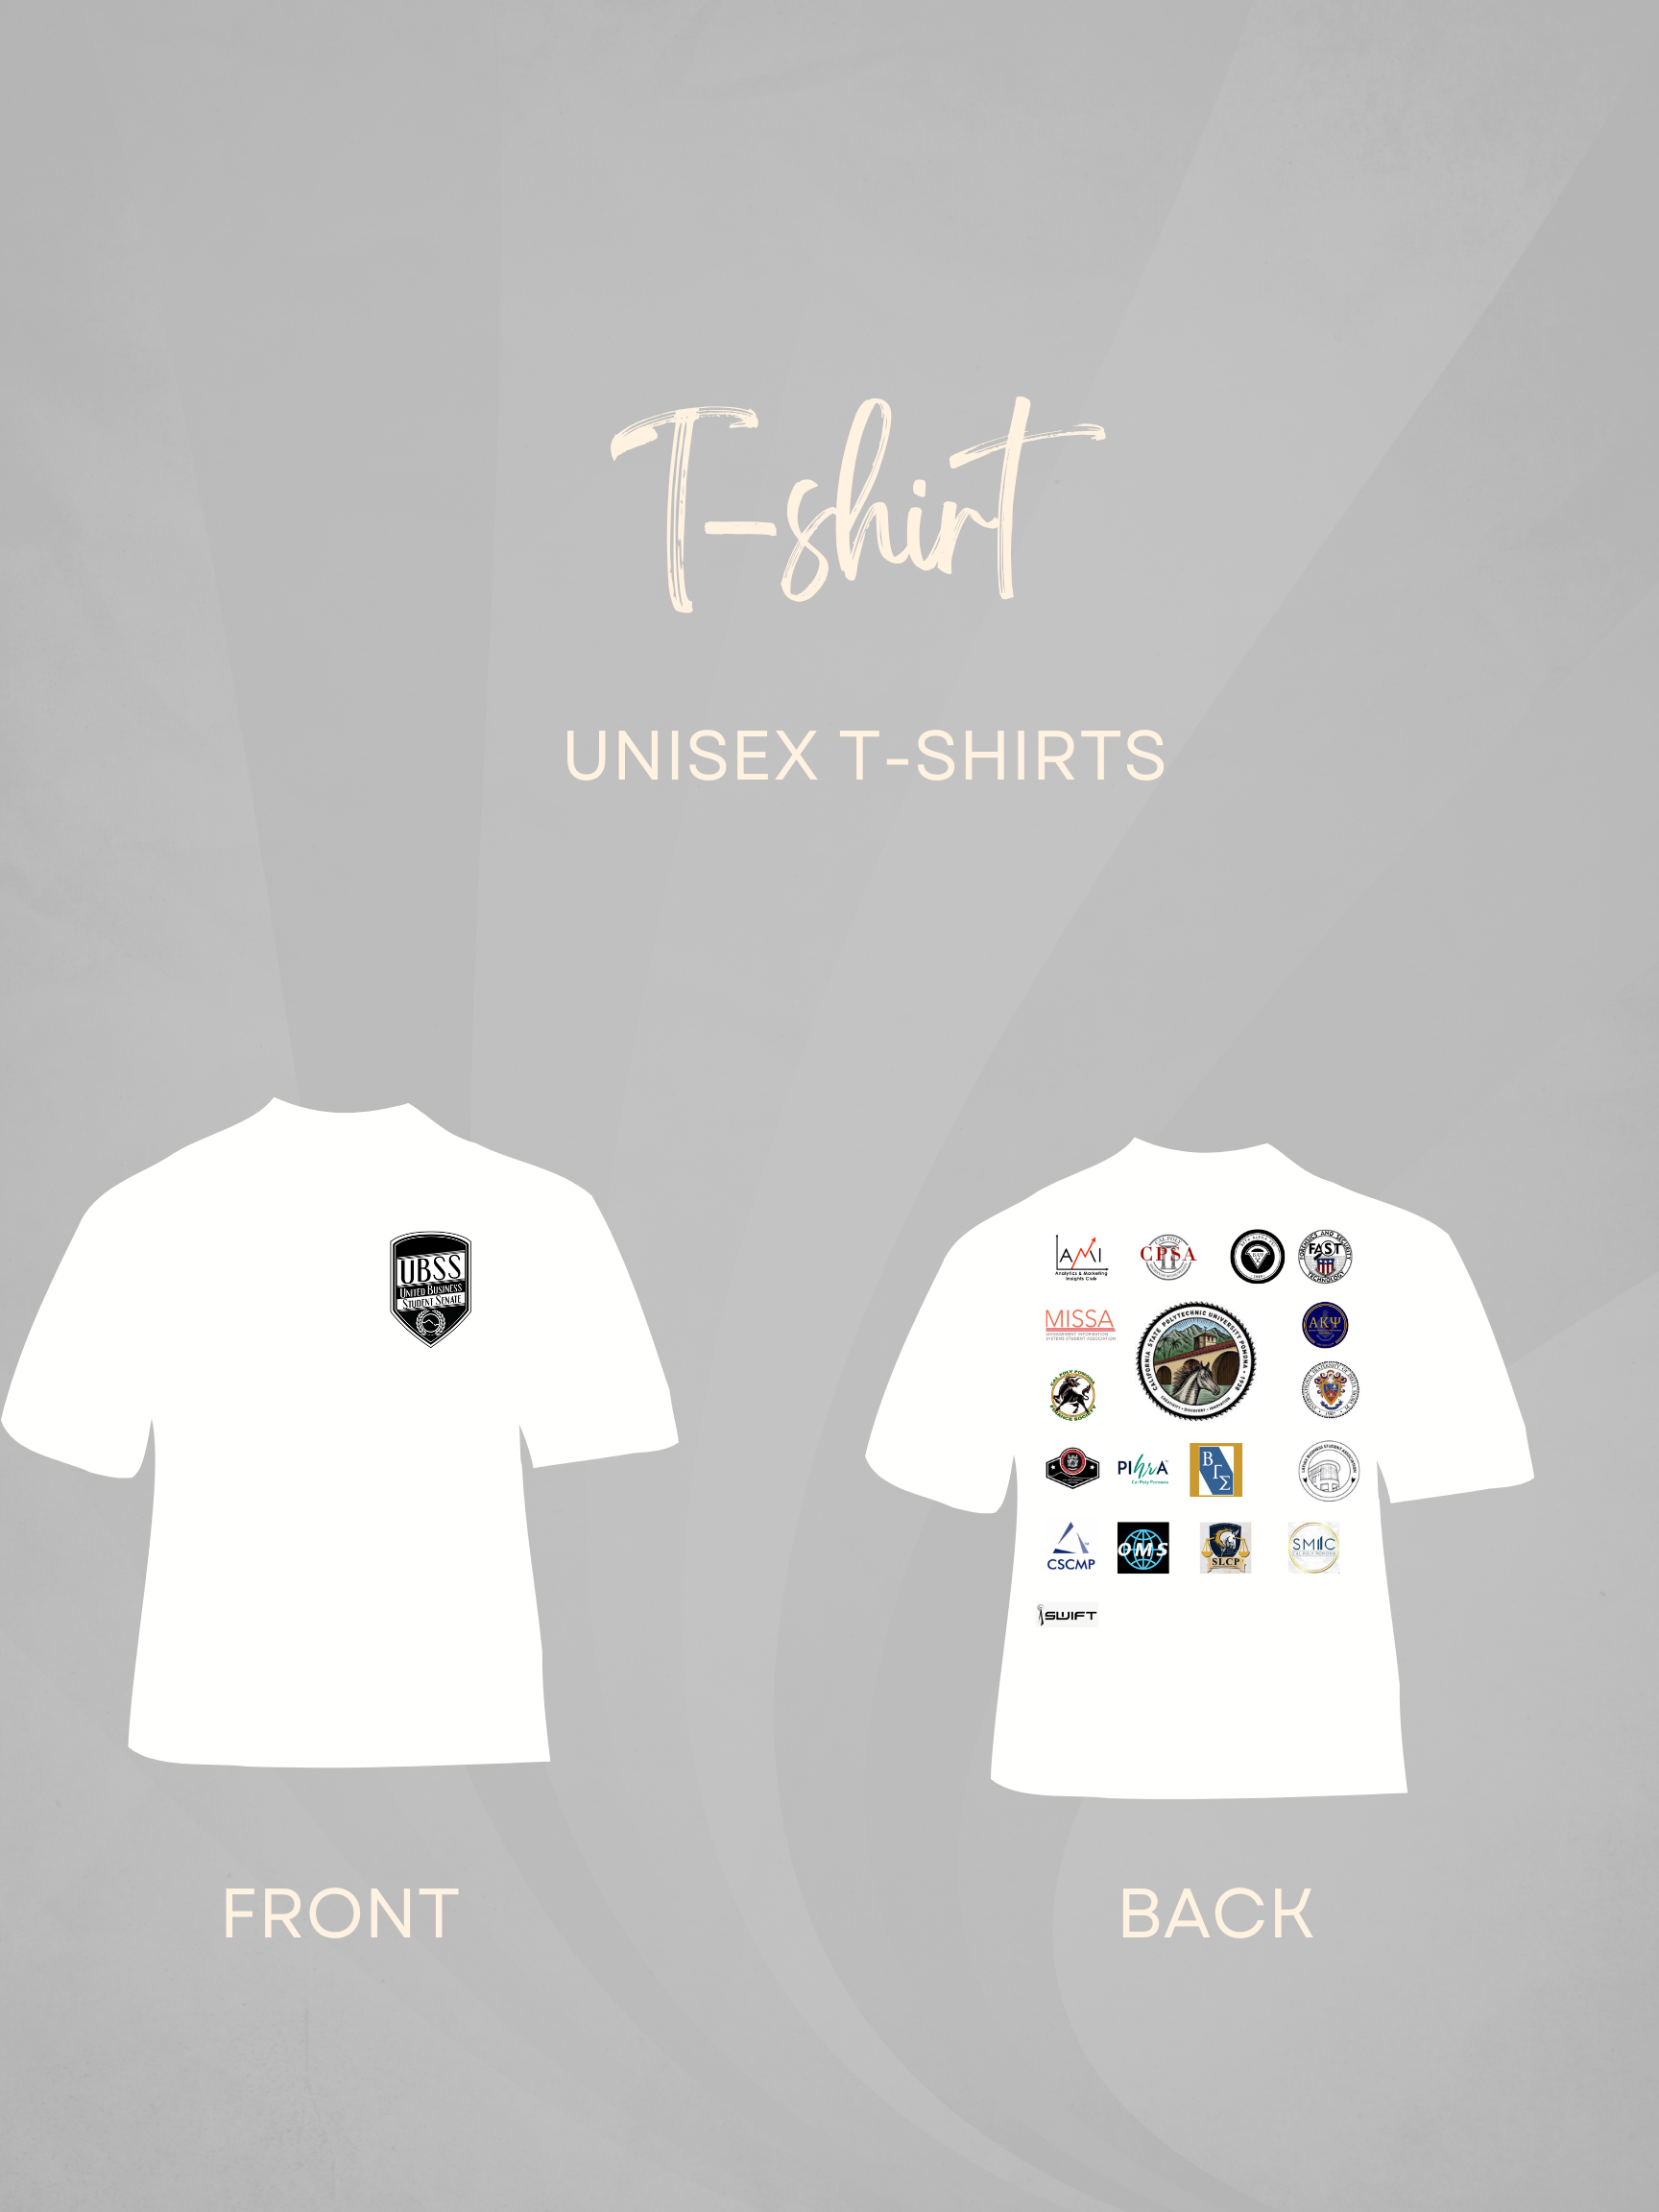
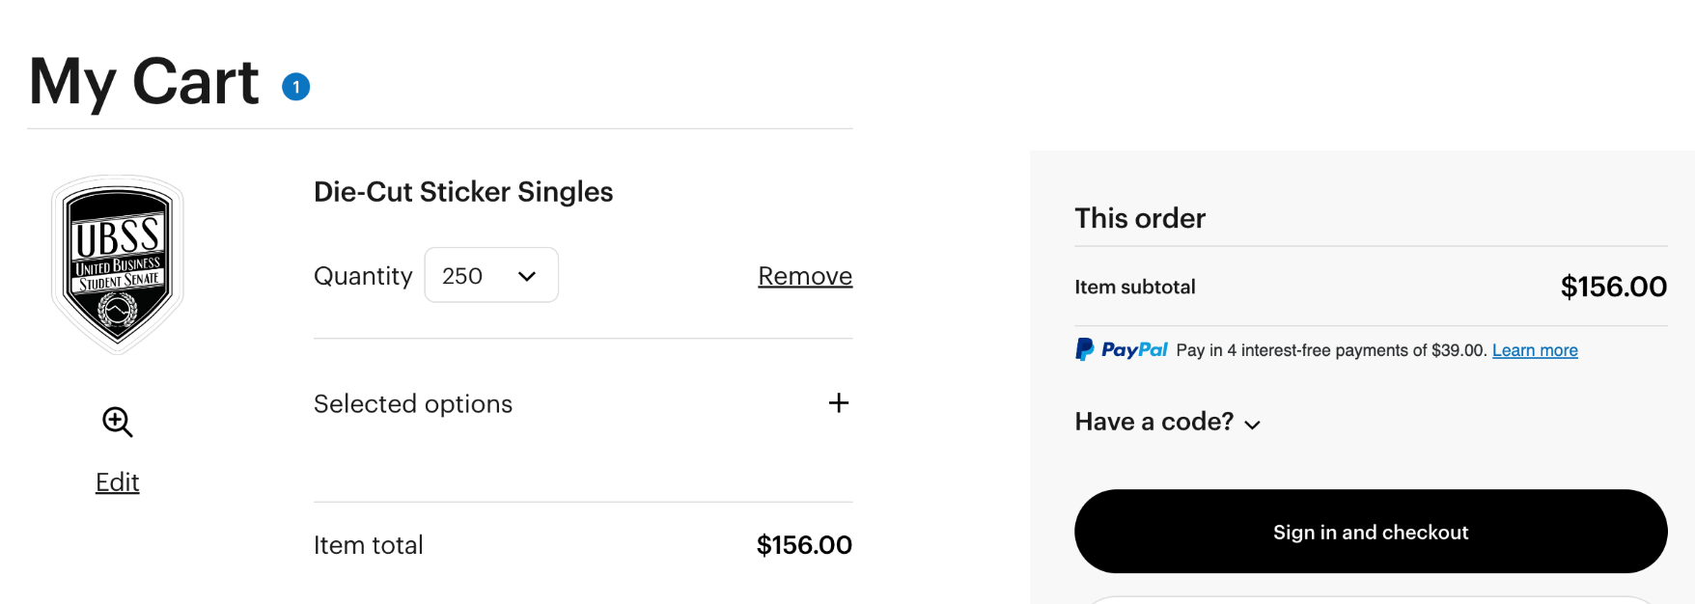
Merch
Notes:
Sarah

Slide 5
BUDGET TRACKER
Merch
Cost | Quantity | DESCRIPTION | AMOUNT
$10 $11 $12 | 100 100 100 | $10 x 100 $11 x 100 $12 x 100 | $1000 $1100 $1200
Notes:
Sarah

Slide 6
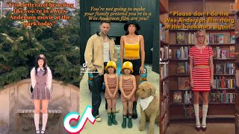
Social Media
Instagram | 2 week notice post, 1 more post week prior Brand image: student turn out
Tik Tok | Trendy TikTok promotions EXAMPLE: Wes anderson themed marketing Goal- higher interaction and views with shorter videos
Discord | Hub to promote to all club members
Notes:
Jennie

Slide 7
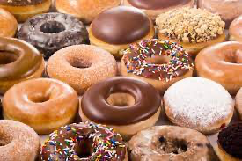


Events
Donut Day
Free for students, if they follow UBSS on all social media accounts
Middle of Semester
21 Club Participation in Rose Garden
Crafts, games, or food
10% off + raffle entry → students who attended past events
20% off + 2 raffler entries → students who attended past events + following all social media
Notes:
Helen

Slide 8
Performance Measurement
Marketing Channel | Type | Methods
Social Media | Instagram, TikTok, Discord | App engagement stats
Merch | Stickers, Shirts, Tote bags | Amount given away, Quantity after each event
Print Media | Flyers, PolyPost, Bronco guide | QR codes, Surveys, Quality of Papers taken, Quantity given out
Online Media | Email blast, PolyPost, Bronco Bytes | Clicked Links
Events | Middle-of-Semester, Donut Day | Counting each person stopped at booth, QR Codes
Notes:
Amanda

Slide 9

Thank You!
Any Questions?

